Slide 1


Slide 2
Machine Learning for Cyber Security (CS-602) L#02
Introduction – R Programming
By
Dr Sunita Dhavale

Slide 3
Syllabus
Data Analytics Foundations: R programming, Python Basics -Expressions and Variables, String Operations, Lists and Tuples, Sets, Dictionaries Conditions and Branching, Loops, Functions, Objects and Classes, Reading/Writing files, Hand ling data with Pandas, Scikit Library, Numpy Library, Matplotlib, scikit programming for data analysis, setting up lab environment, study of standard datasets. Introduction to Machine Learning- Applications of Machine Learning, Supervised, unsupervised classification and regression analysis
Python libraries suitable for Machine Learning Feature Extraction. Data pre-processing, feature analysis etc., Dimensionality Reduction & Feature Selection Methods, Linear Discriminant Analysis and Principal Component Analysis, tackle data class imbalance problem

Slide 4
Syllabus
Supervised and regression analysis, Regression, Linear Regression, Non-linear Regression, Model evaluation methods, Classification, K-Nearest Neighbor, Naïve Bayes, Decision Trees, Logistic Regression, Support Vector Machines, Artificial Neural Networks, Model Evaluation. Ensemble Learning, Convolutional Neural Networks, Spectral Embedding, Manifold detection and Anomaly Detection
Unsupervised classification K-Means Clustering, Hierarchical Clustering, Density-Based Clustering, Recommender Systems- Content-based recommender systems, Collaborative Filtering, machine learning techniques for standard dataset, ML applications, Case studies on Cyber Security problems that can be solved using Machine learning like Malware Analysis, Intrusion Detection, Spam detection, Phishing detection, Financial Fraud detection, Denial of Service Detection.

Slide 5
Text/Reference Books
1. Building Machine Learning Systems with Python – Willi Richert, Luis Pedro Coelho 2. Alessandro Parisi, Hands-On Artificial Intelligence for Cybersecurity: Implement smart AI systems for preventing cyber attacks and detecting threats and network anomalies Publication date :Aug 2, 2019, Packt, ISBN-13, 9781789804027 3. Machine Learning: An Algorithmic Perspective – Stephen Marsland 4. Sunita Vikrant Dhavale, “Advanced Image-based Spam Detection and Filtering Techniques”, IGI Global, 2017 5. Soma Halder , Sinan Ozdemir, Hands-On Machine Learning for Cybersecurity: Safeguard your system by making your machines intelligent using the Python ecosystem, By Publication date : Dec 31, 2018, Packt, ISBN-13 :9781788992282
1. Stuart Russell, Peter Norvig (2009), “Artificial Intelligence – A Modern Approach”, Pearson Elaine Rich & Kevin Knight (1999), “Artificial Intelligence”, TMH, 2nd Edition 2. NP Padhy (2010), “Artificial Intelligence & Intelligent System”, Oxford 3. ZM Zurada (1992), “Introduction to Artificial Neural Systems”, West Publishing Company 4. Research paper for study (if any) – White papers on multimedia from IEEE/ACM/Elsevier/Spinger/ Nvidia sources.

Slide 6
Lab assignments
1 | Python Programming part-1
2 | Python Programming part-2
3 | Study and Implement Linear Regression Algorithm for any standard dataset like in cyber security domain
4 | Study and Implement KMeans Algorithm for any standard dataset in cyber security domain
5 | Study and Implement KNN for any standard dataset in cyber security domain
6 | Study and Implement ANN for any standard dataset in cyber security domain
7 | Study and Implement PCA for any standard dataset in cyber security domain
8 | Case Study: Use of ML along with Fuzzy Logic/GA to solve real world Problem in cyber security domain
9 | Mini assignment: Apply ML along with PSO/ACO to solve any real world problem in cyber security domain
10 | ML Practice Test – 1 Quiz

Slide 7
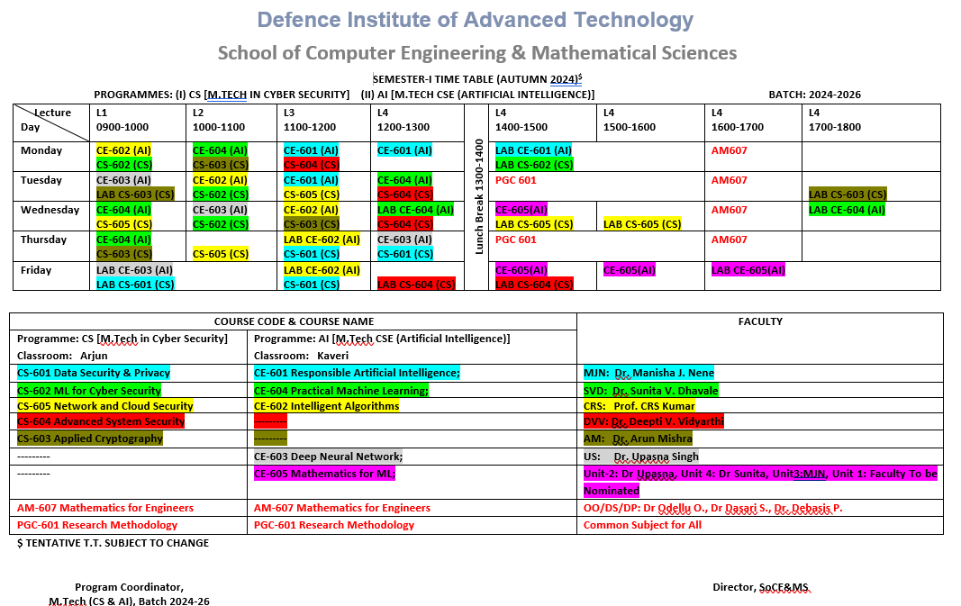

Slide 8
Basic R Programming

Slide 9
R
R, as a dialect of GNU-S, is a powerful statistical language that can be used to manipulate and analyze data.
R provides many machine learning packages and visualization functions
R is open source and free.
Using R greatly simplifies machine learning.
R is an interpreted language also means that you can execute R commands directly and see an immediate result.
All you need to know is how each algorithm can solve your problem, and then you can simply use a written package to quickly generate prediction models on data with a few command lines.
Ross Ihaka and Robert Gentleman. R: A language for data analysis and graphics. Journal of Computational and Graphical Statistics, 5(3):299–314, 1996

Slide 10
R with R-Studio
set up the R environment and integrated development environment, RStudio.
Official website (http://www.rproject.org/).
You may select the mirror location closest to you.
https://www.rstudio.com/
RStudio provides comprehensive facilities for software development. Built-in features such as syntax highlighting, code completion, and smart indentation help maximize productivity.

Slide 11
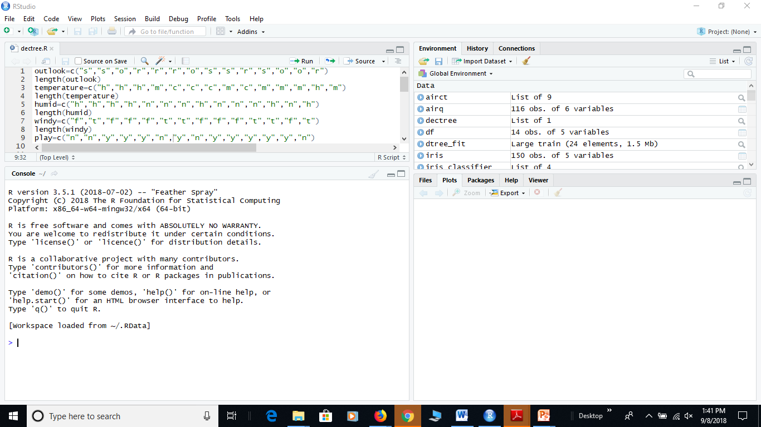
Console Pane/Script Pane/History Pane/Environment Pane/Plots Pane
Run section of script/Source tab to run entire script

Slide 12
Just Start
To load a list of installed packages:
> library()
2. Setting the default CRAN (Comprehensive R Archive Network) mirror:
> chooseCRANmirror()
R will return a list of CRAN mirrors, and then ask the user to either type a mirror ID to select it, or enter zero to exit:
Install a package from CRAN; take package “e1071” as an example:
> install.packages("e1071")
e1071 -Misc Functions of the Department of Statistics, Probability Theory

Slide 13
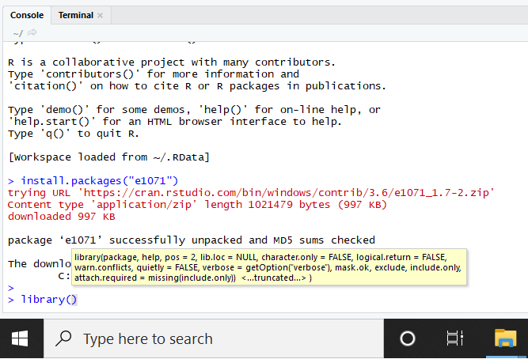
Load library
Update a package from CRAN; take package e1071 as an example:
> update.packages("e1071")
Load the package the package:
> library(e1071)
To view the documentation of the package,
> help(package="e1071")

Slide 14
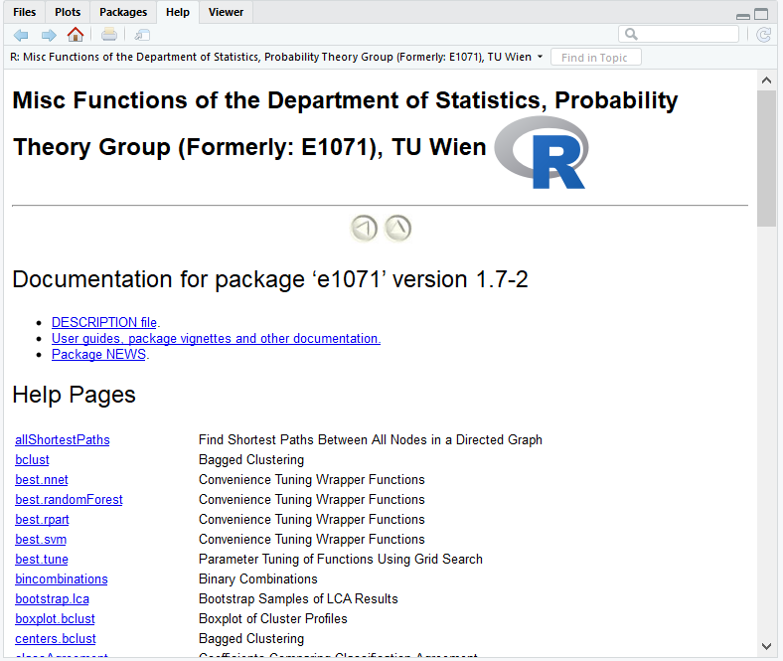

Slide 15
Help
To view the documentation of the function, you can use the help function:
> help(svm, e1071)
> ?e1071::svm
> ??svm (in some versions)
to know the argument taken for the lm function:
> args(lm)
To view an example or demo.
> example(lm)
> demo(graphics)
To view all the available demos
library(help = "graphics")
> demo()

Slide 16
Set directory path
Create your own directory say “PML_Lab_Assignments”
type getwd() in the R session to obtain the current working directory location.
change the current working directory,
setwd("<path>"), where <path> can be replaced as your desired path, to specify the working directory.
getwd()
To run script file: source('R_basics.R')

Slide 17
DATA TYPES IN R
The logical data type is a simple binary variable that may have only two values: TRUE or FALSE. also commonly referred to as flags. E.g. Married Variable.
The numeric data type stores decimal numbers, while the integer data type stores integers.
If you create a variable containing a number without specifying a data type, R will store it as numeric by default. However, R can usually automatically convert between the numeric and integer data types as needed.
R also calls the numeric data type double, which is short for a double-precision floating-point number. The terms numeric and double are interchangeable.
The character data type is used to store text strings of up to 65,535 characters each.

Slide 18
DATA TYPES IN R
The factor data type is used to store categorical values. Each possible value of a factor is known as a level. For example indian states
The ordered factor data type is a special case of the factor data type where the order of the levels is significant. For example, risk ratings of Low, Medium, and High
There is also a special number Inf which represents infinity. This allows us to represent entities like 1/0. This way, Inf can be used in ordinary calculations; e.g. 1/Inf is 0.
The value NaN represents an undefined value (“not a number”); e.g. 0/0; NaN can also be thought of as a missing value.

Slide 19
Try some commands
> x <- 1
> print(x)
[1] 1
> x
[1] 1
> class(x)
[1] "numeric“
> x='hello'
> class(x)
[1] "character“
> x=FALSE
> class(x)
[1] "logical“

Slide 20
Commands
> x=integer(3)
> class(x)
[1] "integer”
> print(x)
[1] 0 0 0
x <- 10:30
Print(x)
rm(list = ls()) //clears all workspace
rm(objectname)

Slide 21
Add/Sub/Mul/Div
2+3
2*3
2**3
10/3
7^3
10 %% 2
10 %% 3
10 %/% 3
10 %/% 2
floor(10/3)
ceiling(10/3)
Sqrt(4)
Sqrt(-1)
Exp(1)
log2(8)
Pi

Slide 22
Vector
The most basic type of R object is a vector. Empty vectors can be created with the vector() function.
A vector can only contain objects of the same class.
The c() function can be used to create vectors of objects by concatenating things together.
> x <- c(0.5, 0.6) ## numeric
> x <- c(TRUE, FALSE) ## logical
> x <- c(T, F) ## logical
> x <- c("a", "b", "c") ## character
x <- vector("numeric", length = 10)
> x
[1] 0 0 0 0 0 0 0 0 0 0
If you explicitly want an integer, you need to specify the L suffix. So entering 1 in R gives you a numeric object; entering 1L explicitly gives you an integer object.
seq(from = 2, by = -0.1, length.out = 4) //sequence of numbers
Seq(1,10,0.5)

Slide 23
List
A list is represented as a vector but can contain objects of different classes.
> y <- c(1.7, "a") ## character
> y <- c(TRUE, 2) ## numeric
> y <- c("a", TRUE) ## character
cars <-list(name =c("Honda","BMW","Ferrari"),color =c("Black","Blue","Red"), cc =c(2000,3400,4000))
cars$name
# character indicates a comment. Anything to the right of the # (including the # itself) is ignored.
This is the only comment character in R. Unlike some other languages, R does not support multi-line comments or comment blocks

Slide 24
Indexing
x=seq(from = 2, by = -0.1, length.out = 4)
x[1]
x[2:3]
x[c(2,1)]
y=x>=1.9
y
x[y]
x=c(x,19) #append
Vectors are basic objects in R and they can be subsetted using the [ operator.
x <- c("a", "b", "c", "c", "d", "a")
The sequence does not have to be in order; you can specify any arbitrary integer vector.
> x[c(1, 3, 4)]
[1] "a" "c" "c“

Slide 25
Typecast
Objects can be explicitly coerced from one class to another using the as.* functions, if available.
> x <- 0:6
> class(x)
[1] "integer"
> y=as.numeric(x)
[1] 0 1 2 3 4 5 6
is.numeric(x)
class(y)
> as.logical(x)
[1] FALSE TRUE TRUE TRUE TRUE TRUE TRUE
> as.character(x)
[1] "0" "1" "2" "3" "4" "5" "6"

Slide 26
Matrix
m <- matrix(nrow = 2, ncol = 3)
dim(m)
[1] 2 3
attributes(m)
$dim
[1] 2 3
m <- matrix(1:6, nrow = 2, ncol = 3)
m
[,1] [,2] [,3]
[1,] 1 3 5
[2,] 2 4 6
> m <- 1:10
> m
[1] 1 2 3 4 5 6 7 8 9 10
> dim(m) <- c(2, 5)
> m
[,1] [,2] [,3] [,4] [,5]
[1,] 1 3 5 7 9
[2,] 2 4 6 8 10
C(m) #convert to 1D vector

Slide 27
Matrix
Matrix to vector: as.vector(m)
m <- matrix(1:6, nrow = 2, ncol = 3)
n <- matrix(10:15, nrow = 2, ncol = 3)
M+n
M-n
M*n (dot product)
t(n)
m %*% t(n)
crossprod(m,n) #same as t(m)%*%n
rowMeans(m)
rowSums(m)
colSums(m)
colMeans(m)
n1=c(1,2,3)
n2=c(10,20,30)
n1*n2
n1 %*% n2 (matrix multiplication)/crossprod(n1, n2)
n1%o%n2 (outer product)

Slide 28
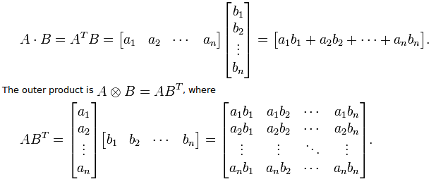

Slide 29
Cbind/rbind
x = 1:3
y = 10:12
cbind(x, y)
x y
[1,] 1 10
[2,] 2 11
[3,] 3 12
rbind(x, y)
[,1] [,2] [,3]
x 1 2 3
y 10 11 12

Slide 30
Factors
Factors are used to represent categorical data.
Having a variable that has values “Male” and “Female” is better than a variable that has values 1 and 2.
Factor objects can be created with the factor() function.
x = factor(c("yes", "yes", "no", "yes", "no"))
x
[1] yes yes no yes no
Levels: no yes
table(x)
no yes
2 3
## See the underlying representation of factor
unclass(x)
[1] 2 2 1 2 1

Slide 31
NA and NaN
Missing values are denoted by NA (Not Available, declared in advance) or NaN (Not a Number i.e. 0/0).
is.na() is used to test objects if they are NA
is.nan() is used to test for NaN
NA values have a class also, so there are integer NA, character NA, etc.
A NaN value is also NA but the converse is not true
## Create a vector with NAs in it
x = c(1, 2, NA, 10, 3)
complete.cases(x)
y=x[complete.cases(x)]
is.na(x)
x = c(1, 2, NaN, NA, 4)
is.na(x)
[1] FALSE FALSE TRUE TRUE FALSE
is.nan(x)
[1] FALSE FALSE TRUE FALSE FALSE

Slide 32
Dataframes
used to store tabular data in R.
Unlike matrices, data frames can store different classes of objects in each column. Matrices must have every element be the same class (e.g. all integers or all numeric).
In addition to column names, indicating the names of the variables or predictors, data frames have a special attribute called row.names which indicate information about each row of the data frame.
Data frames are usually created by reading in a dataset using the read.table() or read.csv().
x = data.frame(foo = 1:4, bar = c(T, T, F, F))
nrow(x)
ncol(x)
class(x$foo)
names <- c('Mike', 'Renee', 'Richard', 'Matthew', 'Christopher')
scores <- c(85, 92, 95, 97, 96)
x <- data.frame(names, scores)

Slide 33
Reading data
There are a few principal functions reading data into R.
read.table, read.csv, for reading tabular data
x = read.table("test1.csv",header=T)
is.data.frame(x)
readLines, for reading lines of a text file source, for reading in R code files (inverse of dump)
dget, for reading in R code files (inverse of dput)
load, for reading in saved workspaces
unserialize, for reading single R objects in binary form
y=read.csv('E:/NTROcourse_2019/R_ppts/test1.csv')
# https://github.com/defcom17/NSL_KDD
#nsl kdd dataset
X=read.csv('Small Training Set.csv')
X=read.csv(‘test2.csv')
head(X)

Slide 34
Writing data
write.table, for writing tabular data to text files (i.e. CSV) or connections
writeLines, for writing character data line-by-line to a file or connection
dump, for dumping a textual representation of multiple R objects
dput, for outputting a textual representation of an R object
save, for saving an arbitrary number of R objects in binary format (possibly compressed) to a file.
serialize, for converting an R object into a binary format for outputting to a connection (or file).
save(m,n,file="ab.Rdata")
Ls()
Rm(x,y)
#cntr-L and rm(list=ls())
load(“ab.RData")
write.table(iris,file="test2.csv")
m=read.table("test2.csv")
Head(m)

Slide 35
Examples
initial <- read.table(“test2.csv")
classes <- sapply(initial, class)
Classes
when using R with larger datasets, it’s also useful to know a few things about your system.
How much memory is available on your system?
What other applications are in use? Can you close any of them?
Are there other users logged into the same system?
What operating system are you using? Some operating systems can limit the amount of memory a single process can access.

Slide 36
Examples
x <- "foo"
y <- data.frame(a = 1L, b = "a")
We can dump() R objects to a file by passing a character vector of their names.
dump(c("x", "y"), file = "data.R")
rm(x, y)
The inverse of dump() is source().
source("data.R")
str(y)
'data.frame': 1 obs. of 2 variables:
$ a: int 1
$ b: Factor w/ 1 level "a": 1
x
[1] "foo"

Slide 37
Examples
key functions for converting R objects into a binary format are save(), save.image(), and
serialize(). Individual R objects can be saved to a file using the save() function.
a <- data.frame(x = rnorm(100), y = runif(100))
b <- c(3, 4.4, 1 / 3)
## Save 'a' and 'b' to a file
save(a, b, file = "mydata.rda")
## Load 'a' and 'b' into your workspace
load("mydata.rda")
If you have a lot of objects that you want to save to a file, you can save all objects in your workspace using the save.image() function.
save.image(file = "mydata.RData")
## load all objects in this file
load("mydata.RData")

Slide 38
Reading special data
con <- gzfile("words.gz")
x <- readLines(con, 10)
x
[1] "1080" "10-point" "10th" "11-point" "12-point" "16-point"
[7] "18-point" "1st" "2" "20-point"
For more structured text data like CSV files or tab-delimited files, there are other functions like read.csv() or read.table(). > ## Open a URL connection for reading
con <- url("http://www.vit.ac.in", "r")
## Read the web page
x <- readLines(con)
## Print out the first few lines
head(x)
[1] "<!DOCTYPE html>"
[2] "<html lang=\"en\">"
[3] ""
[4] "<head>"
[5] "<meta charset=\"utf-8\" />"
[6] "<title>Johns Hopkins Bloomberg School of Public Health</title>"

Slide 39
Example
x <- matrix(1:6, 2, 3)
x
[,1] [,2] [,3]
[1,] 1 3 5
[2,] 2 4 6
We can access the $(1, 2)$ or the $(2, 1)$ element of this matrix using the appropriate indices.
x[1, 2]
[1] 3
x[2, 1]
[1] 2
Indices can also be missing. This behavior is used to access entire rows or columns of a matrix.
x[1, ] ## Extract the first row
[1] 1 3 5
x[, 2] ## Extract the second column
[1] 3 4

Slide 40
Access items
> x <- list(foo = 1:4, bar = 0.6)
> x
$foo
[1] 1 2 3 4
$bar
[1] 0.6
The [[ operator can be used to extract single elements from a list. Here we extract the first element of the list.
> x[[1]]
[1] 1 2 3 4
The [[ operator can also use named indices so that you don’t have to remember the exact ordering of every element of the list. You can also use the $ operator to extract elements by name.
> x[["bar"]]
[1] 0.6
> x$bar
[1] 0.6

Slide 41
removing missing values
> x <- c(1, 2, NA, 4, NA, 5)
> bad <- is.na(x)
> print(bad)
[1] FALSE FALSE TRUE FALSE TRUE FALSE
> x[!bad]
[1] 1 2 4 5
> x <- c(1, 2, NA, 4, NA, 5)
> y <- c("a", "b", NA, "d", NA, "f")
> good <- complete.cases(x, y)
> good
[1] TRUE TRUE FALSE TRUE FALSE TRUE
> x[good]
[1] 1 2 4 5
> y[good]
[1] "a" "b" "d" "f"
You can use complete.cases on data frames too.

Slide 42
Accessing inbuilt datasets
> head(airquality)
Ozone Solar.R Wind Temp Month Day
1 41 190 7.4 67 5 1
2 36 118 8.0 72 5 2
3 12 149 12.6 74 5 3
4 18 313 11.5 62 5 4
5 NA NA 14.3 56 5 5
6 28 NA 14.9 66 5 6
> good <- complete.cases(airquality)
> head(airquality[good, ])
Ozone Solar.R Wind Temp Month Day
1 41 190 7.4 67 5 1
2 36 118 8.0 72 5 2
3 12 149 12.6 74 5 3
4 18 313 11.5 62 5 4
7 23 299 8.6 65 5 7
8 19 99 13.8 59 5 8

Slide 43

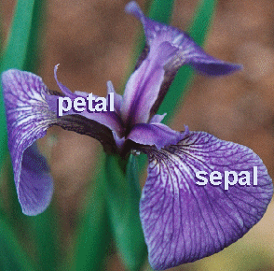
Iris Dataset
virginica
setosa
data() yields many built-in data files.

Slide 44
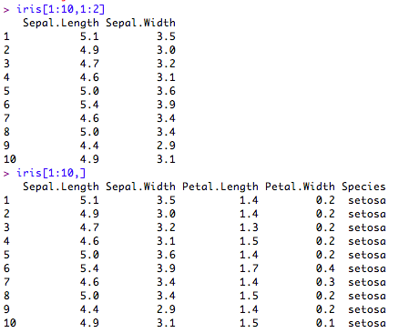
Iris data
df[rows,cols]
As with vectors, you can "subset" data frames.

Slide 45
If a feature represents a characteristic measured in numbers, it is unsurprisingly called numeric.
Alternatively, if a feature is an attribute that consists of a set of categories, the feature is called categorical or nominal.
A special case of categorical variables is called ordinal, which designates a nominal variable with categories falling in an ordered list.
Ordinal variables include such as small, medium, and large

Slide 46
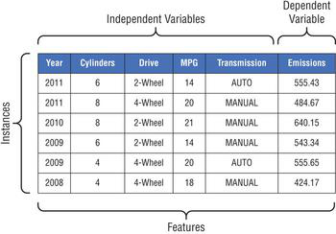
Describing the Data
An instance is a row of data. It is described by a set of attributes or features. A dataset consists of several instances/records/examples/observations.
A feature is a column of data. It is the property or characteristic of an instance. Each instance consists of several features. sometimes refer to features as columns or variables and can be described as either a discrete feature or a continuous feature.
The dimensionality of a dataset represents the number of features in the dataset.

Slide 47
Descriptive/summary statistics for data exploration/understanding
frequency of a feature value tells us how often the value occurs, and the mode of the feature tells us which value occurs the most for that feature.
Frequency and mode are typically used to describe categorical data.
For continuous data, measures such as mean and median are often used to describe the properties of the data.

Slide 48
Tidyverse- collection of packages
install.packages("tidyverse").
library(tidyverse)
includes the packages that you’re likely to use in everyday data analyses
dplyr is a package in the tidyverse that is used for data exploration and manipulation
ggplot2 package for declaratively creating graphics, based on The Grammar of Graphics
tidyr provides a set of functions that help you get to tidy data. Tidy data is data with a consistent form: in brief, every variable goes in a column, and every column is a variable
readr provides a fast and friendly way to read rectangular data (like csv)
purrr - set of tools for working with functions and vectors. allows you to replace many for loops with code that is easier to write and more expressive.
Other packages are tibble , stringr, forcats

Slide 49
Example – ggplot2
# load the library
library("ggplot2")
# create the dataframe with letters and numbers
gfg =data.frame(x=c('Amit', ‘Aditi', ‘ganesh', 'Dina', ‘rina', 'Farina'),y=c(80, 80, 100, 75, 70, 50))
# display the bar
ggplot(gfg, aes(x, y, fill=x)) + geom_bar(stat="identity")

Slide 50
Examples – dpylr for data manipulation
group_by() /mutate() /select() /filter() /summarise() /arrange() function
library(dplyr)
head(starwars)
Pipes are written as %>%. They are provided by the magrittr package, which is loaded as part of the tidyverse.
X=starwars %>% select(height)
table(X)
starwars %>% select(name:mass) %>% table() %>% prop.table()
print(starwars %>% filter(species == "Droid"))
Tibble-> like dataframe but shows only 1st 10 rows/all columns that fit on screen. Easy to work with large data.

Slide 51
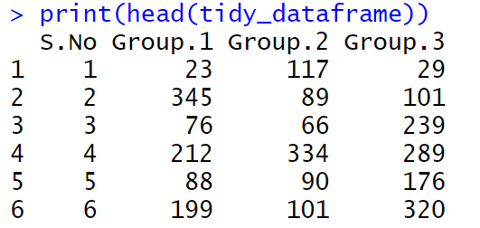
Examples – tidyr for data manipulation
library(tidyr)
n = 10
# creating a data frame
tidy_dataframe = data.frame(S.No = c(1:n),Group.1 = c(23, 345, 76, 212, 88,199, 72, 35, 90, 265),Group.2 = c(117, 89, 66, 334, 90,101, 178, 233, 45, 200), Group.3 = c(29, 101, 239, 289, 176,320, 89, 109, 199, 56))
# print the elements of the data frame
print(head(tidy_dataframe))

Slide 52
Examples – stringr - data cleaning and data preparation tasks
# R program for finding length of string
# Importing package
library(stringr)
# Calculating length of string
str_length('deva shree ganesha')

Slide 53
If/for/while
x <- runif(1, 0, 10)
#random number using uniform distribution
if(x > 3) {
y <- 10
} else {
y <- 0
}
for(i in 1:10) {
print(i)
}
x <- matrix(1:6, 2, 3)
for(i in seq_len(nrow(x))) {
for(j in seq_len(ncol(x))) {
print(x[i, j])
}
}
Explore:
While loop
Repeat loop
Next
break

Slide 54
Functions
f <- function(num=1) {
hello <- "Hello, world!\n"
for (i in seq_len(num)) {
print(hello)}
Return(num+1)
}
f(2)
f(4)
L=f(5)
//use list to return multiple values
x=c(10,9,3,5)
scaleval=function(x){y=(x-min(x))/(max(x)-min(x))+return(y)}
scaleval(x)
x <- list(a = 1:10, beta = exp(-3:3), logic = c(TRUE,FALSE,FALSE,TRUE))
# compute the list mean for each list element
lapply(x, mean)

Slide 55
Image processing
install.packages("magick")
library(magick)
x <- image_read("test1.jpg")
image_info(x)
Print(x)
y=image_charcoal(x)
Print(y)
image_write(y, path = ‘test2.png', format = ‘png')

Slide 56
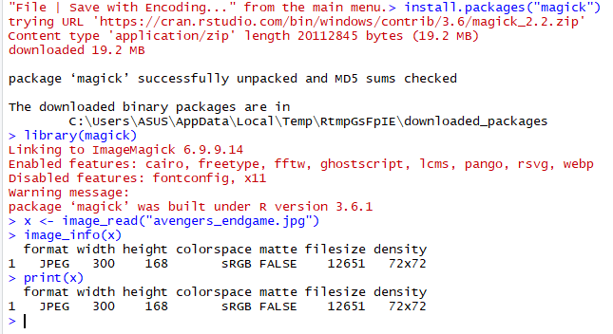
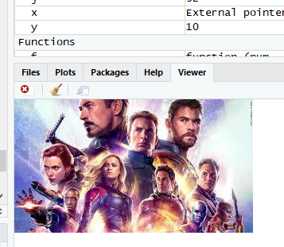

Slide 57
Thank you
Submit Assignments.

Slide 58
References
https://courses.washington.edu/css490/2012.Winter/lecture_slides/02_math_essentials.pdf
Christopher Bishop: ”Pattern Recognition and Machine Learning” , 2006
Kevin Murphy: ”Machine Learning: a Probabilistic Perspective”
David Mackay: ”Information Theory, Inference, and Learning Algorithms”
Ethem Alpaydin: ”Introduction to Machine Learning” , 2nd edition, 2010.
R. Duda, P. Hart & D. Stork, Pattern Classification (2nd ed.), Wiley T. Mitchell, Machine Learning, McGraw-Hill

